Slide 1
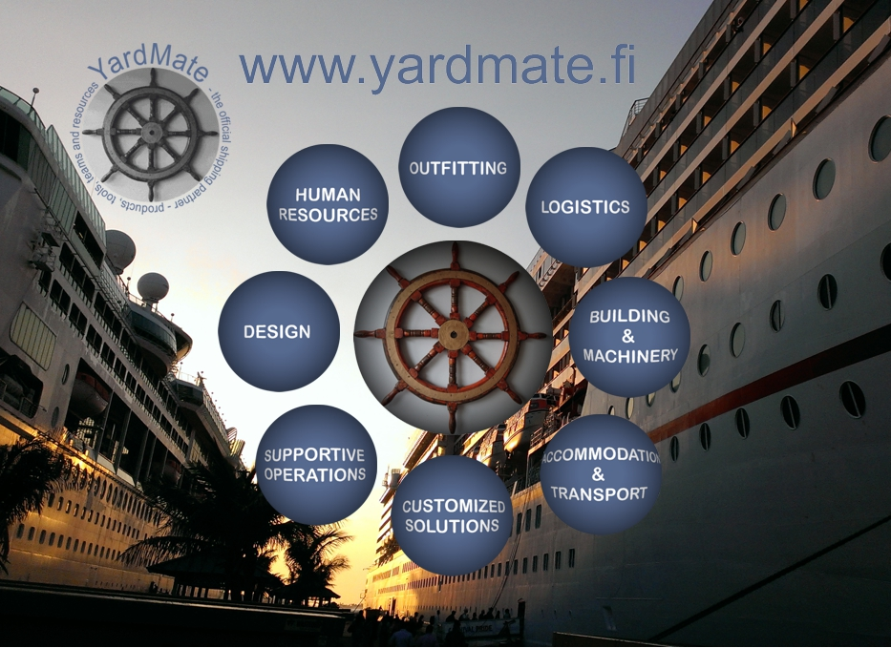
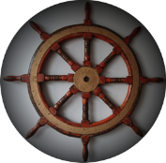

Shipyards,
Cruise Lines, Airlines, Industry
Prospects
Sub-contractors
Potential
Strong recommendation
Resources
Innovations, patents

Slide 2
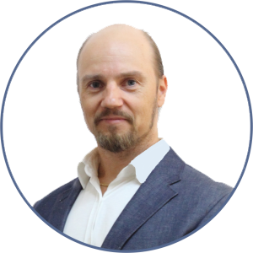
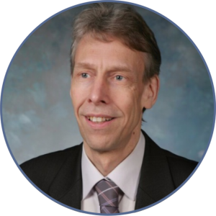
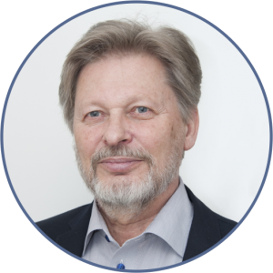
Key persons
Kari Härkönen (80 % ownership)
Personnel Analyst, Cognitive Scientist (Engineering + psychology)
M.Sc. (+Dr. Studies ongoing), Engineer, Electric Technician
In industry since 1989: Power Plant, IT (Ericsson), Finance, Marine
Ismo Karjalainen (10 % ownership)
Experienced in domestic & international sales (20+ years in Nokia)
Start-up companies growth-expertise, 10+ years
Risto Anttila
Founder of Haklift ABT Oy (Haklift became market leader in Finland, Estonia and Lithuania)
40 years in sales, marketing and leadership

Slide 3
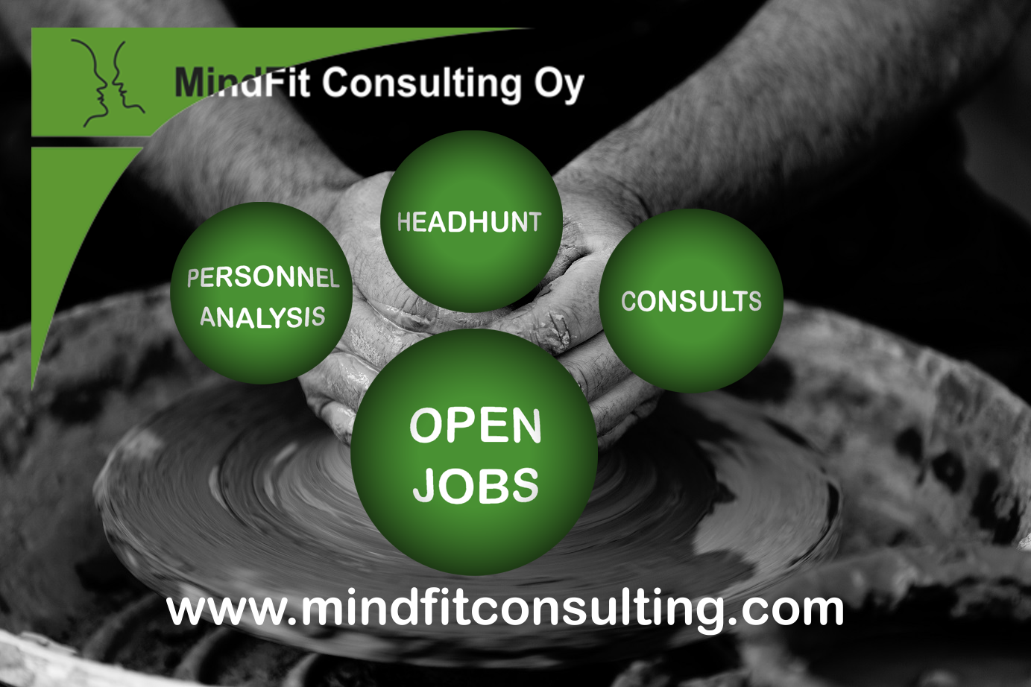
Kari Härkönen
Electric Technician, Computer Engineer, Cognitive Scientist (FM, Ph.D ongoing)
Industry background: IT/IN/AI, Mobile, Finance (Ericsson, Hex/OMX,…)
MindFit Consulting Ltd,
founder (2003-> )
YardMate™, founder (2017-> )

Slide 4
YardMate – Gateway to industry
Matches resources, services and new innovations to industry needs
Central validation channel for marine, aviation and other industry
- Helps industry to find the right turn key providers and sub-contractors
- Finds the right human resources
Opens members possibilities to get customers
- and/or to find the right place in the sub-contracting chain
100+ member companies:
1) Turn Key providers
2) Sub-contractors
3) Companies offering services to other members

Slide 5

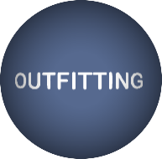
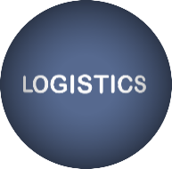



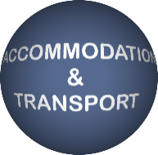
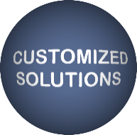
      MEMBERS FIT IN THE FOLLOWING SERVICE ARES
      Recruitment, employee rental, headhunting, HR help
      Technology and material production and interiors
      Physical, digital and electronic material flow
      Architectures, interior design, outdoor and indoor furnising
      Large components, machines, parts
      All the supportive products, material and services
      Housing arrangements, rooms, work force transport
      Customizes products, parts and services accoring to customer needs

Slide 6
Focus in innovations and patented products
ENERGY AND ENVIRONMENT SAVING
COST-EFFECTIVE (production cost vs. income per m2)
ECOLOGIC LONG TERM SOLUTION
Examples
- Fuel consumption & CO₂ emissions reduction (-20 %), Finno Exergy
- Patented composite pumps and parts, SIMS
- Articial wave for open water, Artwave

Slide 7
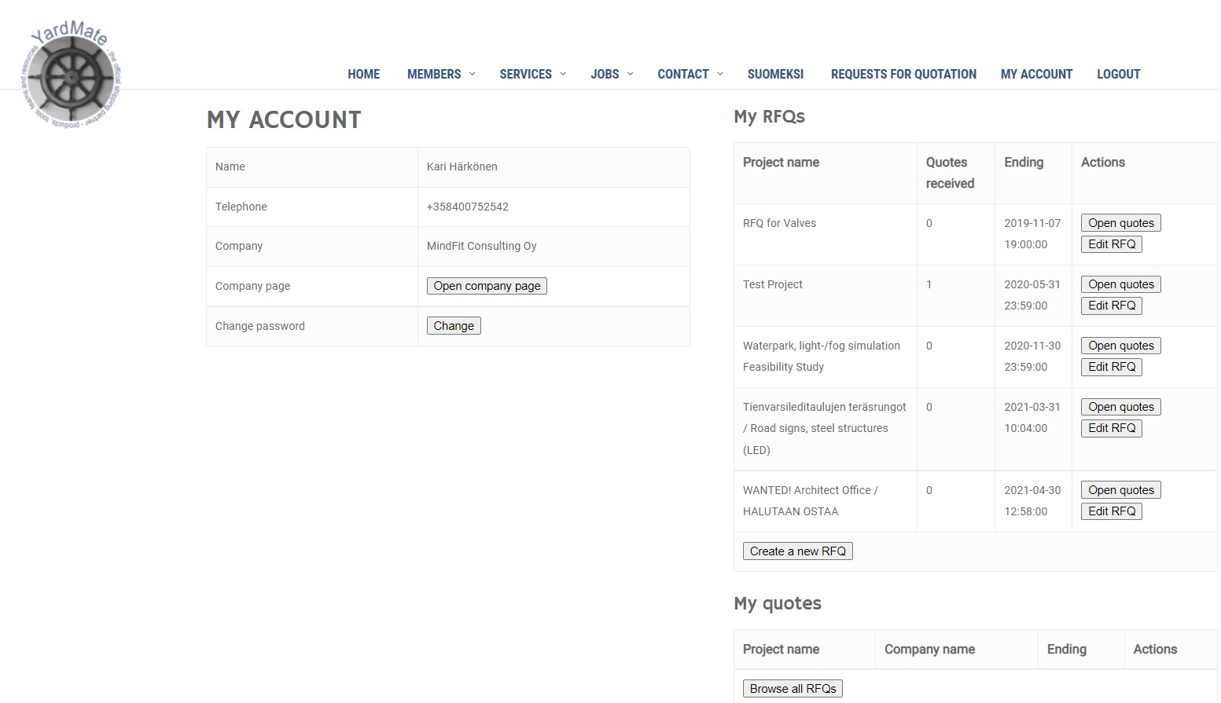
Request For Quote for members and customers
Customers (shipyards, cruise lines, etc.) can leave RFQs
YardMate members can quote (leave their offers)
Easy follow-up for all the RFQ activities:

Slide 8
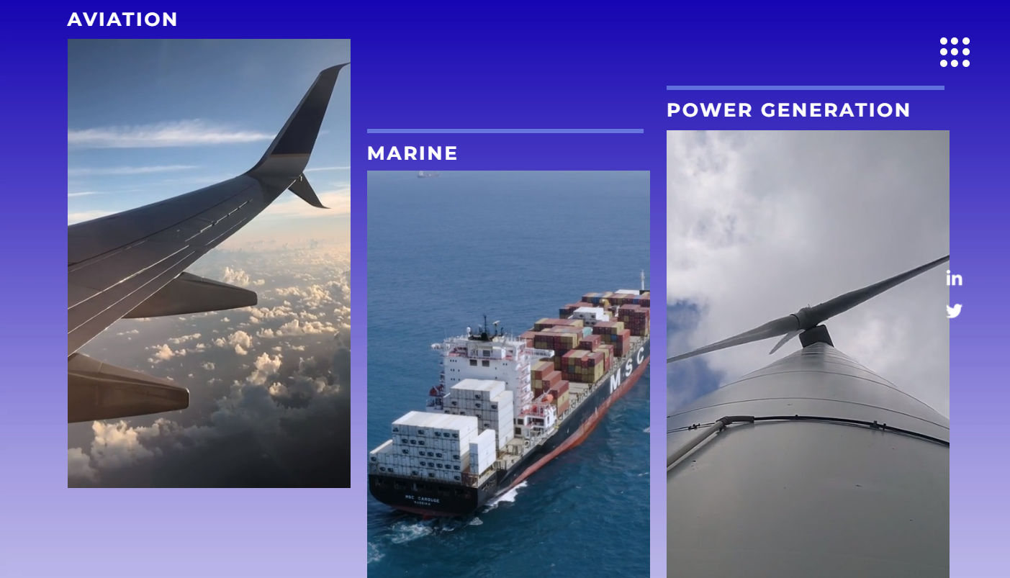
YardMate – Finno Exergy
A combined cycle power plant 1GW
  Fuel cost reduction of
  22,4 M€
  156 000 tons CO₂ reduction
  = 65 000 cars off the road
One Boeing 747 could save yearly:
  9 000 000 litres of fuel
  3 860 000 € savings
  22 400 tons of CO₂ = 10 000 cars off the road

Slide 9
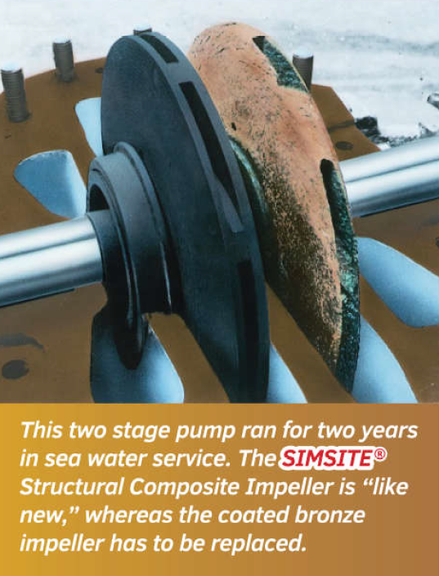
YardMate - SIMS
Composite Impellers and parts in marine industry
Replaces the traditional metal accessories with corrosion free parts
Stonger, corrosion free, maintenance free, cost efficient
              http://www.yardmate.fi/en/sims
              https://www.simsite.com/brouchure
              https://www.simsite.com/references

Slide 10
YardMate - SIMS
Savings based on impeller and casing ring replacement
During the 4 years the savings per one (1) pump
- about 10 000 USD (maintenance)
- about 24 000 USD (energy)
-> savings per pump ~34 000 eur
Savings
per one vessel / ship
If 100 pumps
-> savings 3.400.000 USD

Slide 11

YardMate – Artwave Surf
Artwave Surf™ – Artificial wave for sea, lake, river or any water
Patented technology for building wave
Can be installed in any open water or beach
              http://www.yardmate.fi/en/artwave
              https://www.youtube.com/watch?v=ydJIvDTOrEE
              https://www.youtube.com/watch?v=7OCNJ1QIYUc&t=53s

Slide 12
YardMate - Kotopro
Kotopro – Document and process handler

Slide 13
Customer baseline
Royal Caribbean Cruises
Rauma Marine Constructions
Helsinki Shipyard
Airbus

Slide 14
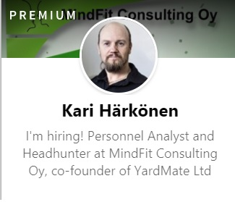
THANK YOU!
kari.harkonen@yardmate.fi
www.yardmate.fi
www.mindfitconsulting.com
P. +358 400 752 542
www.yardmate.fi

