Slide 1
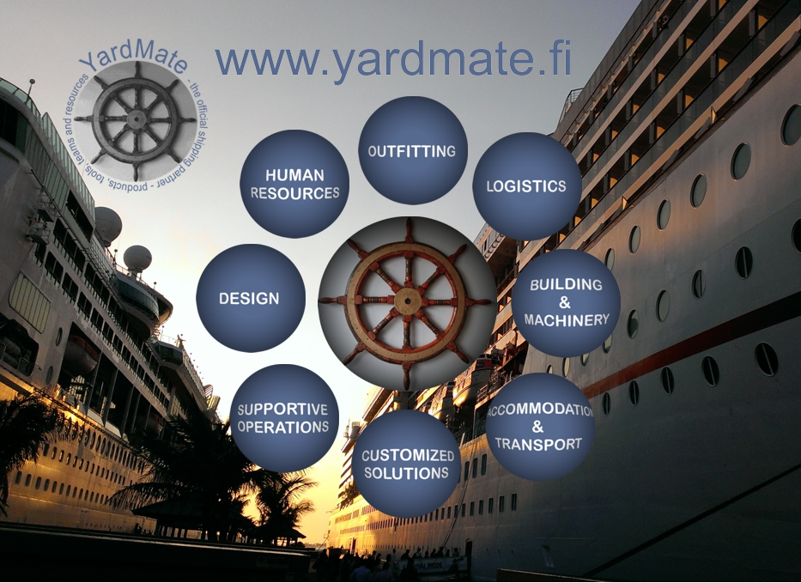
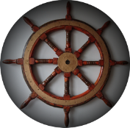
Shipyards, Cruise Lines, Airlines, Industry
Prospects
Sub-contractors
Potential
Strong recommendation
Resources
Innovations, patents

Slide 2
Kari Härkönen
Electric Technician, Computer Engineer, Cognitive Scientist (FM, Ph.D ongoing)
Industry background: IT/IN/AI, Mobile, Finance (Ericsson, Hex/OMX,…)
MindFit Consulting Ltd (founder 2003->), Personnel & Competence Analyst
YardMate™, founder (2017-> ), Corporate matcmaking
Service Design & Matchmaking since 1996

Slide 3
YardMate – on our way to XR
The term "metaverse" originated in the 1992 science fiction novel Snow Crash, as a portmanteau of "meta" and "universe".^{[6][7][page needed]} Metaverse development is often linked to advancing virtual reality technology due to increasing demands for immersion.^{[8][9][10]}
^{- Wikipedia -}

Slide 4
YardMate – on our way to XR
Design Competences:
Showreel on web: https://yardmate.fi/material_open/DesignReform/VRShowreelCut_1min.mp4
Showreel scetchfab: https://yardmate.fi/material_open/DesignReform/design_reform_showroom_at_sketchfab_orig.mp4 or live: https://skfb.ly/ovJRO
Health & Therapy:
For better (mental) health for industry employees (yards, etc.)
Easy & secure platform
1-2-1 discussions with employees WITHOUT remarks in ‘omakanta’: https://yardmate.fi/material_open/images/TherapyPlatform.jpeg
Personal Security Pass:
For personnel safety, emergency situations etc.
NFC also as an id to IoT system and XR world

Slide 6
YardMate – Gateway and industry Organizer
Organizes resources, services and new innovations to industry
Central validation channel for marine, aviation and other industry - Helps industry to find the right turn key providers and sub-contractors - Finds, tests and delivers the right human resources - Tests and validates the best possible service and provider for industry need
Opens members possibilities to get customers
100+ member companies: 1) Turn Key providers 2) Sub-contractors 3) Companies offering services to other members

Slide 7
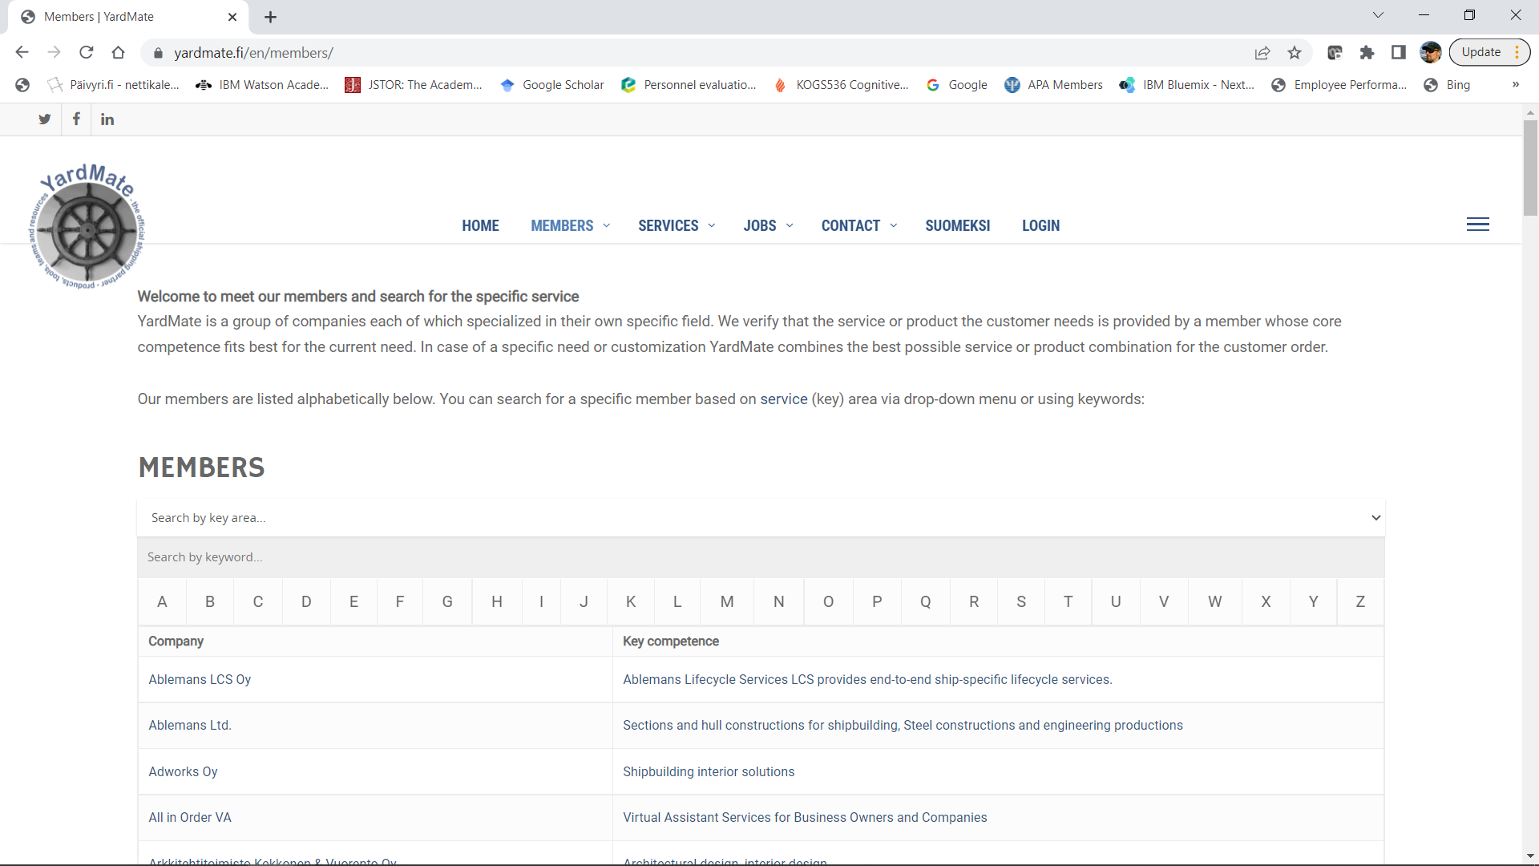
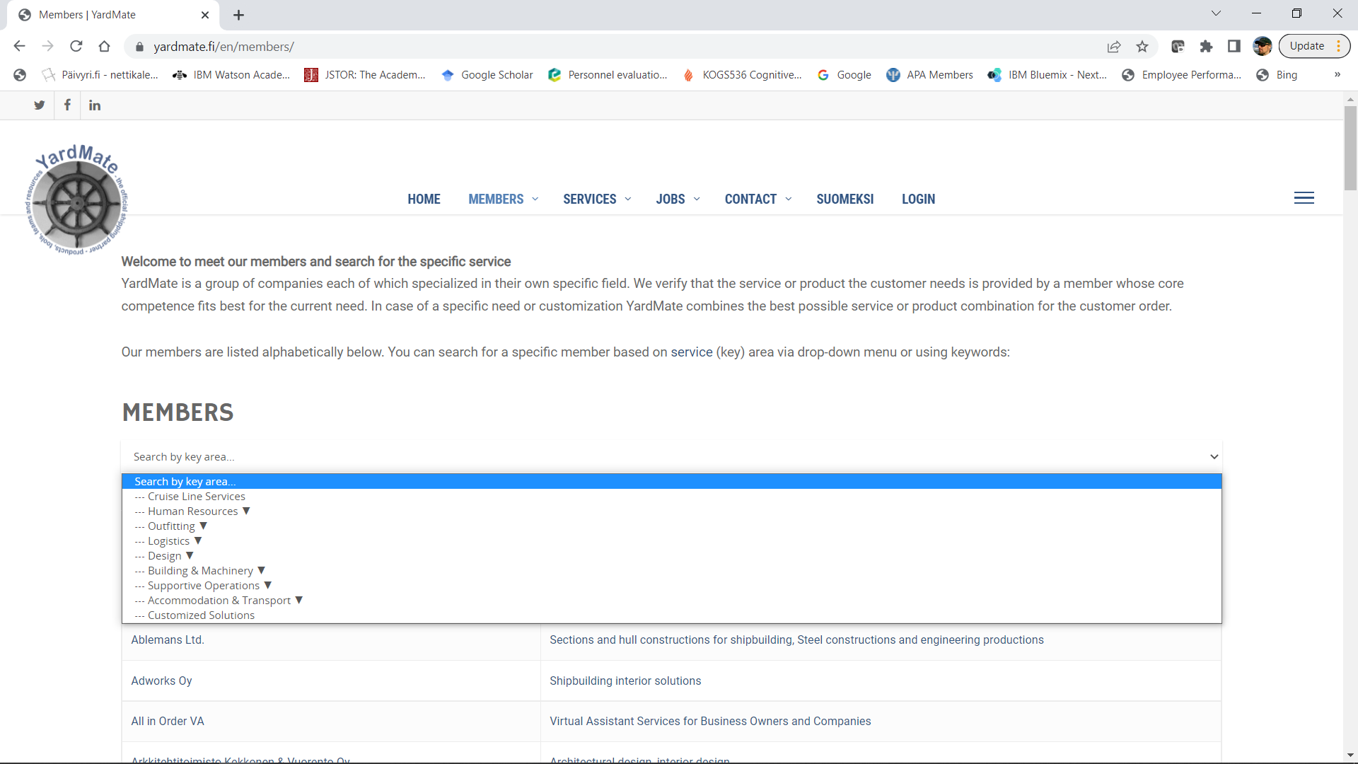
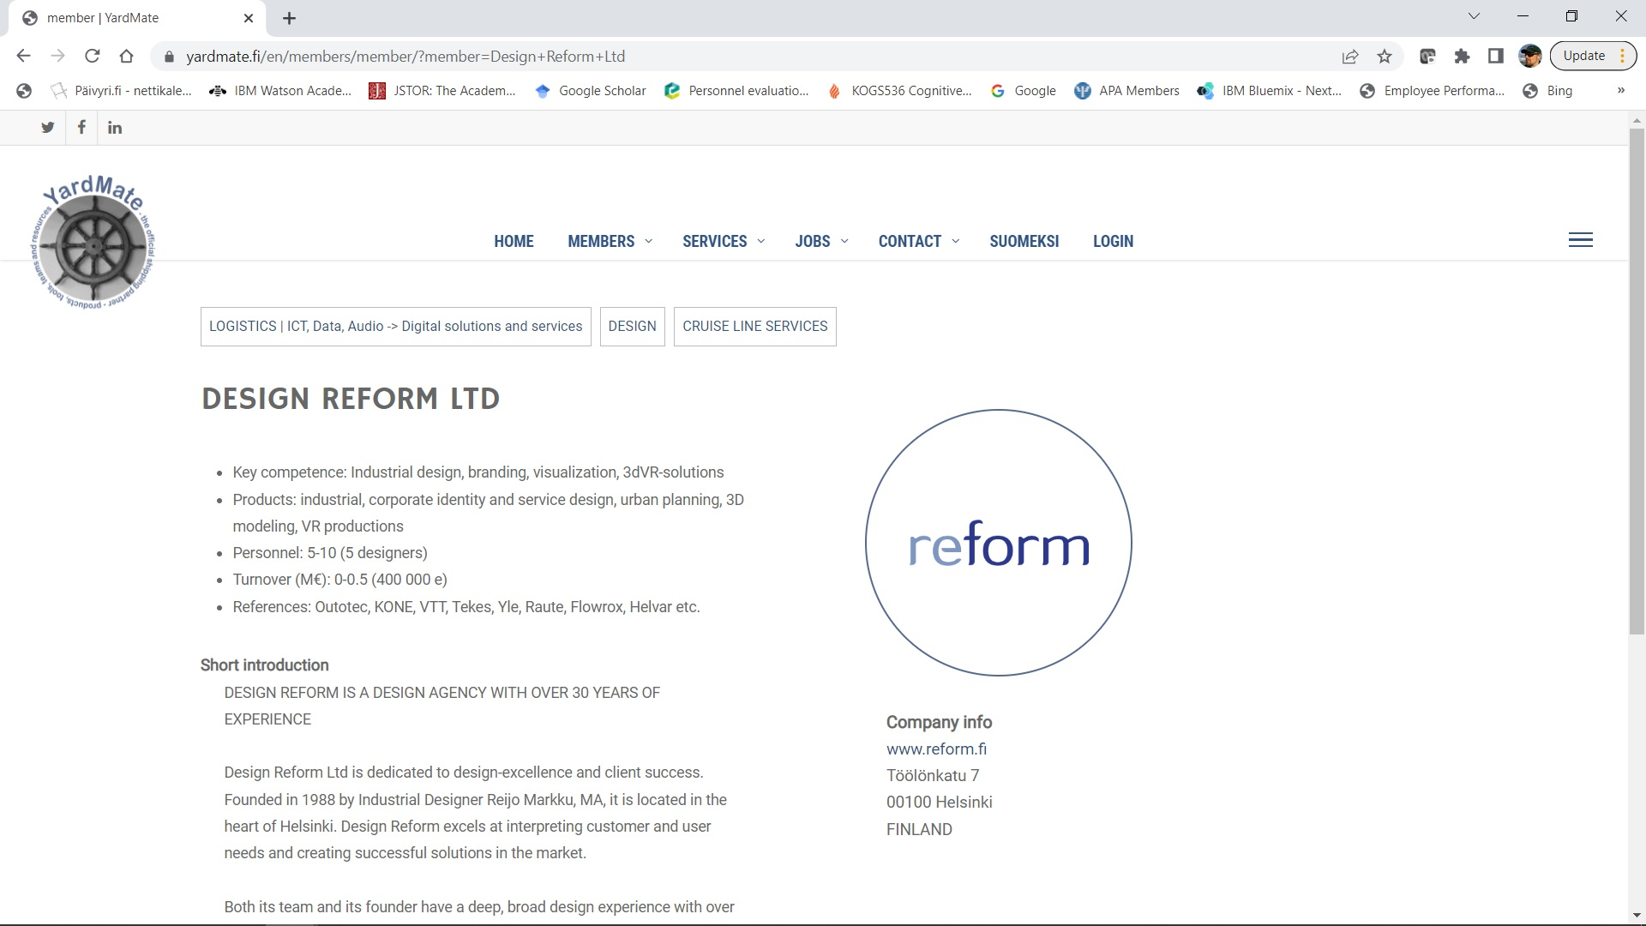

Slide 8
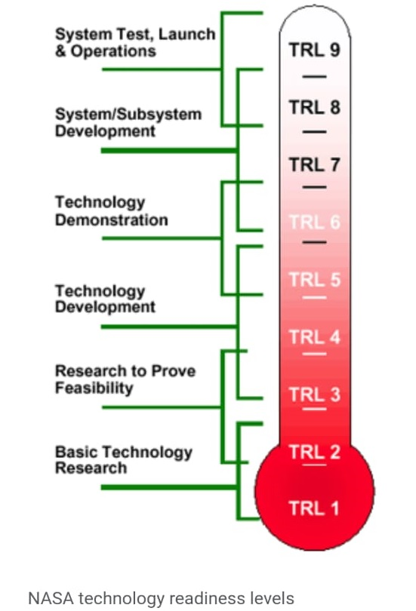
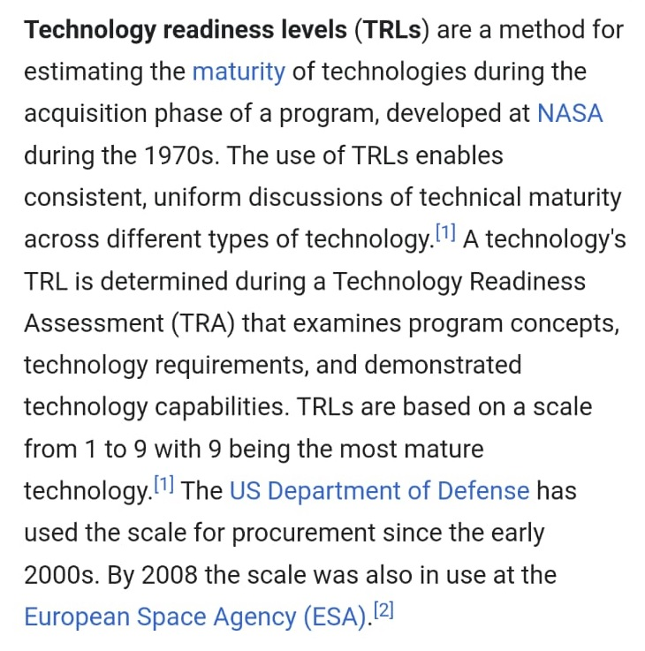
2021 – Proof of Concept and more
YardMate Business Model: Find -> Evaluate -> Present -> Deliver - Matchmaking and support during the process - Provision from the deals - Proofed it works - YardMate’s technical platform high in TRL

Slide 9
2021 – Proof of Concept cases
CASE: Rauma Marine Constructions - Recognized they would be benefiting more flexible oil deliveries - YardMate member automated their measurement and logistics - During 2021-2022 delivered all the oils (~200 kl) needed in yard area
CASE: Helsinki Shipyard - Yard was interested in decreasing their energy consumption - YardMate member optimized their engines/machines using AI and mathematic algorithms
CASE: Airbus (PGC turbine: https://vimeo.com/448920754/9044b477e9) - Aviation field has a strong agenda to decrease CO2 emissions - YardMate has patented member innovation for gas turbines - Airbus wanted us to find engine manufacturer into R&D project - YardMate matched all together, member, engine company and Airbus in order to set up R&D

Slide 10
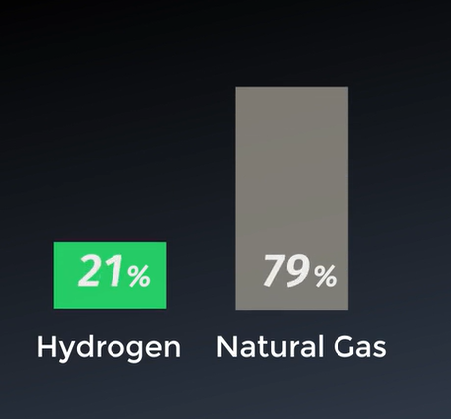
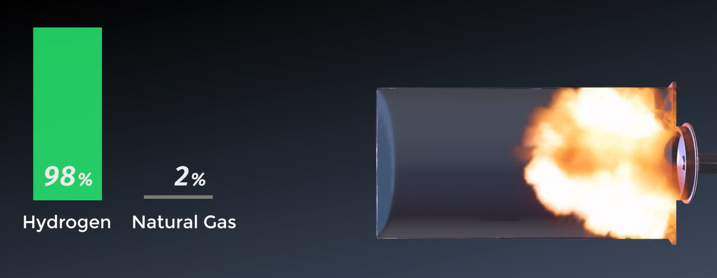

Slide 11
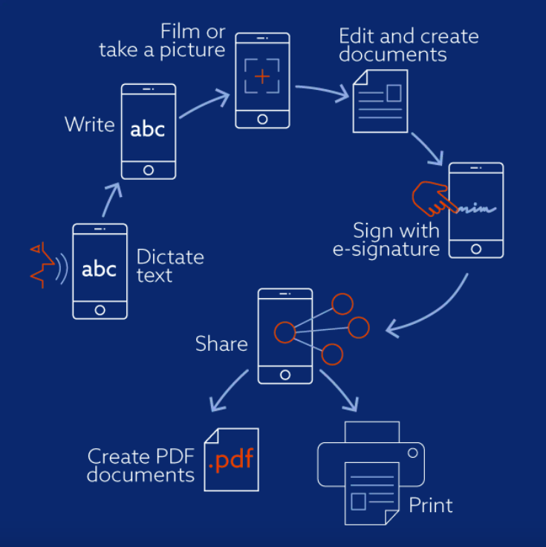
YardMate – Yard Organizer
Work, project and document handler for large operations
Subcontractor management
ORGANIZING TOOL
Fast & easy way to keep track on activities
Organize sub-contractors
Handle documents
Collect data, share docs
ORGANIZING TOOL
Fast & easy way to keep track on activities
Organize sub-contractors
Handle documents
Collect data, share docs
ORGANIZING TOOL
Fast & easy way to keep track on activities
Organize sub-contractors
Handle documents
Collect data, share docs

Slide 12
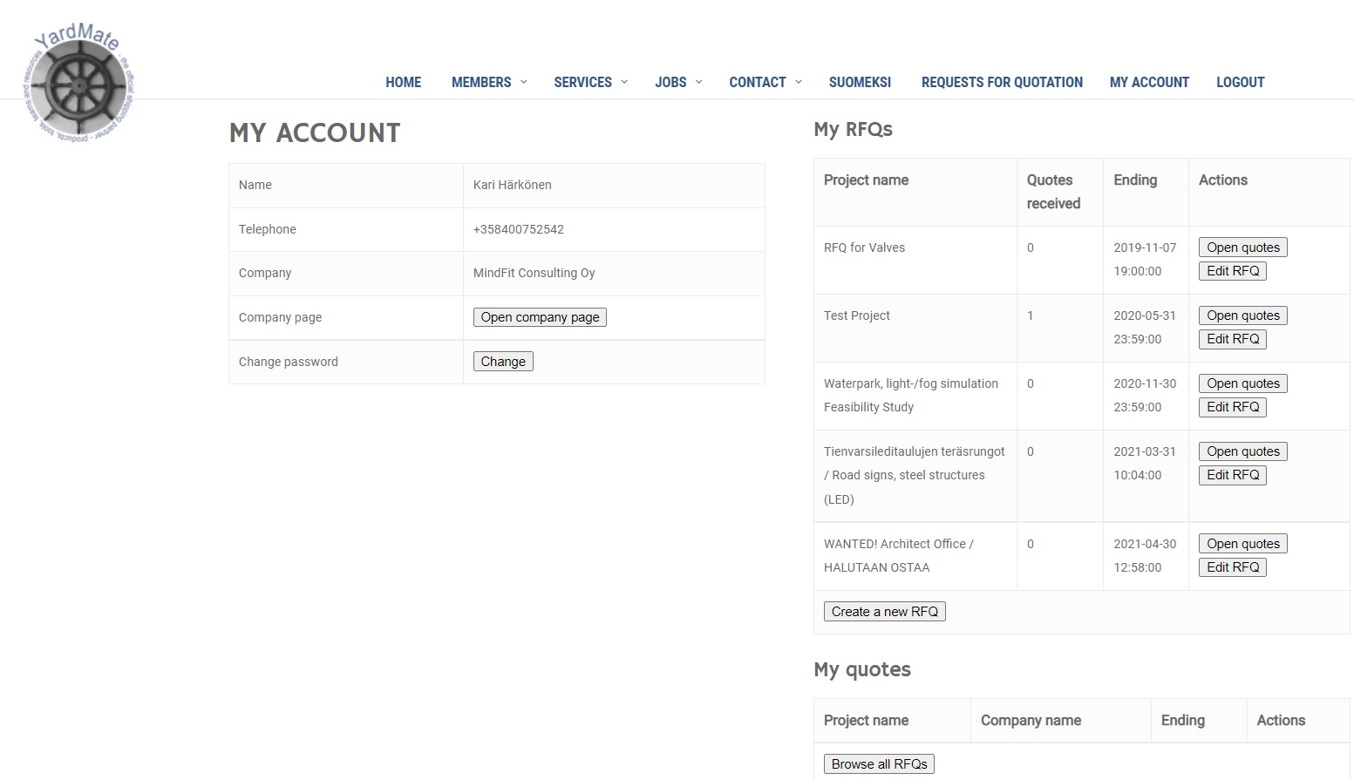
Request For Quote channel
Customers (shipyards, cruise lines, etc.) can leave RFQs
YardMate members can quote (leave their offers)
Easy follow-up for all the RFQ activities:

Slide 13
Member Innovation example (TRL 7)
Artwave Surf™ – Artificial wave for sea, lake, river or any OPEN water
Patented technology for building waves
Can be installed in any open water or beach resort WITHOUT disturbing the environment (ecologic system)
http://www.yardmate.fi/en/artwave
https://www.youtube.com/watch?v=ydJIvDTOrEE
https://www.youtube.com/watch?v=7OCNJ1QIYUc&t=53s

Slide 14
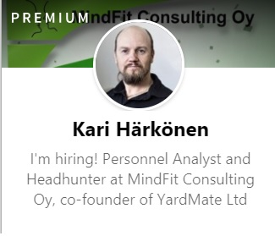
THANK YOU!
kari.harkonen@yardmate.fi www.yardmate.fi
P. +358 400 752 542
www.yardmate.fi

